Slide 1
Titrations

Slide 2
Indicators in Acid-Base Titrations
In an acid-base titration, an indicator needs to be selected that will change colour at the same time that the neutralisation reaction is finished.
Equivalence point: The point in a titration at which chemically equivalent amounts of acid and base have been added.
For a 1:1 mole ratio (e.g. HCℓ + NaOH) this is when equal moles of acid and base have been added.
For a 2:1 mole ratio (e.g. H₂SO₄ + NaOH) this is when n(H₂SO₄) added = 2 x n(NaOH)
End point: The point in a titration at which the indicator changes colour
If an appropriate indicator has been picked, the equivalence point and the end point will be the same.

Slide 3
Indicators in Acid-Base Titrations
Common indicators. Bolded = Remember! Non-bolded = Here for reference only
Indicator | Colour on acidic side | Range of colour change | Colour on basic side
Methyl violet | Yellow | 0.0 - 1.6 | Violet
Bromophenol blue | Yellow | 3.0 - 4.6 | Blue
Methyl orange | Red | 3.1 - 4.4 | Yellow
Methyl red | Red | 4.4 - 6.2 | Yellow
Litmus | Red | 5.0 - 8.0 | Blue
Bromothymol blue | Yellow | 6.0 - 7.6 | Blue
Phenolphthalein | Colourless | 8.3 - 10.0 | Pink
Alizarin yellow | Yellow | 10.1 - 12.0 | Red

Slide 4
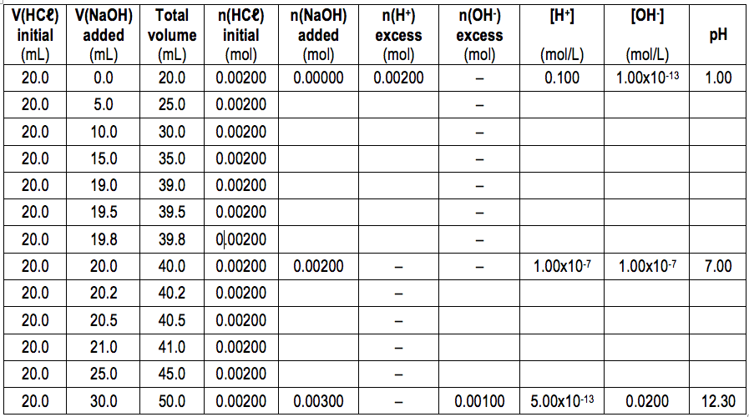
Changes in pH during a titration

Slide 5
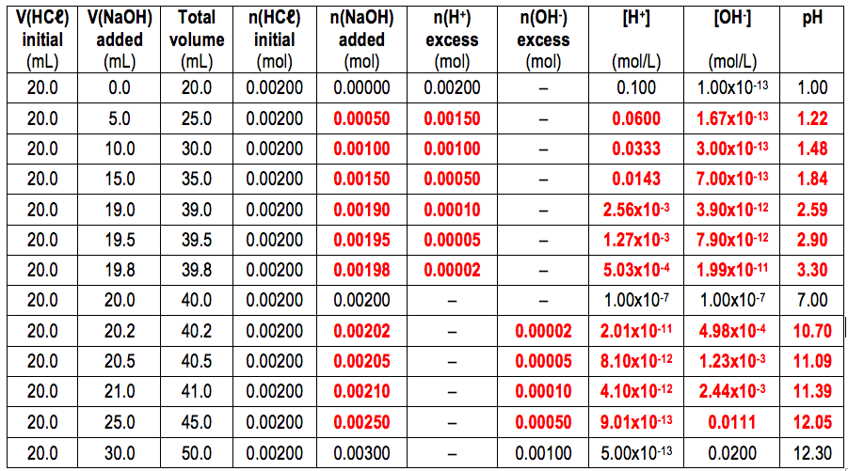
Changes in pH during a titration

Slide 6
Changes in pH during a titration
On the graph, label the equivalence point.
What is the volume of NaOH added at the equivalence point? _______ mL
If you were using phenolphthalein indicator, at what volume would the indicator change colour from colourless to purple?
If you were using methyl orange indicator, at what volume would the indicator change colour from red to yellow?
On the basis of your answers above, explain whether phenolphthalein and/or methyl orange indicator would be suitable for this titration.
Equivalence point

Slide 7
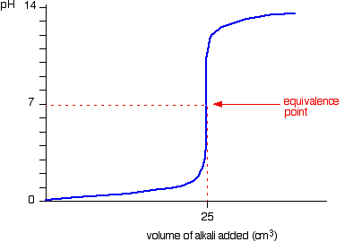
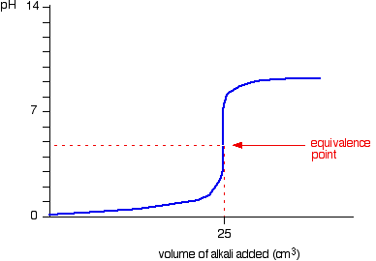
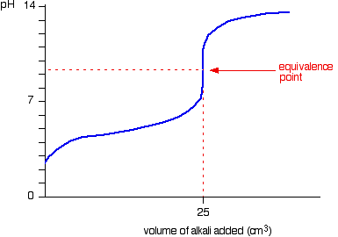
Changes in pH during a titration
Strong Acid + Strong Base
Strong Acid + Weak Base
Weak Acid + Strong Base
e.g. HCℓ and NaOH
e.g. HCℓ and NH₃
e.g. CH₃COOH and NaOH

Slide 8
The pH curves show that each reaction has a different equivalence point. Explain the differences in equivalence point for each of these reactions. Include relevant equations in your answer.
The products of Reaction #1 are NaCℓ and H₂O. Both of these substances produced are neutral. (The salt, NaCℓ, does not undergo hydrolysis with water)
The products of Reaction #2 are NH₄Cl and H₂O. NH₄Cl is acidic due to the presence of the NH₄⁺ ion, which undergoes hydrolysis to produce H₃O⁺.
NH₄⁺(aq) + H₂O(ℓ) ⇌ NH₃(aq) + H₃O⁺(aq)
Therefore, the equivalence point for the reaction between HCℓ and NH₃ is acidic.
The products of Reaction #1 are NaCH₃COO and H₂O. NaCH₃COO is basic due to the presence of the CH₃COO⁻ ion, which undergoes hydrolysis to produce OH⁻ ions.
CH₃COO⁻(aq) + H₂O(ℓ) ⇌ CH₃COOH(aq) + OH⁻(aq)
Therefore, the equivalence point for the reaction between CH₃COOH and NaOH is basic.

Slide 9
Choosing an Appropriate Indicator
Strong Acid + Weak Base e.g. HCℓ and NH₃
Which indicator would you use for this reaction:
phenolphthalein or methyl orange
Explain.

Slide 10
Choosing an Appropriate Indicator
Weak Acid + Strong Base e.g. CH₃COOH + NaOH
Which indicator would you use for this reaction:
phenolphthalein or methyl orange
Explain.

Slide 11
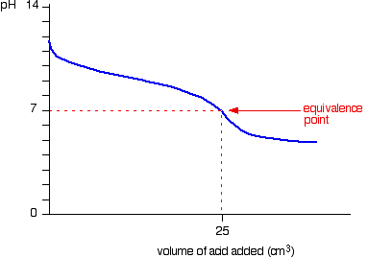
Choosing an Appropriate Indicator
Weak Acid + Weak Base e.g. CH₃COOH + NH₃
You will probably not come across a weak acid-weak base titration.
There is no ‘steep part’ on the titration curve for this combination. This makes it difficult to find the equivalence point using an indicator.
For these types of titrations you would normally use a pH meter and generate a pH graph like to one to the left to find the equivalence point.

Slide 12
Standard Solutions
A standard solution is a solution with a known concentration of substance.
Standard solutions can be primary standards or secondary standards.
made up with a known concentration
concentration only known by titrating against other standards

Slide 13
Primary Standards
A primary standard is substance that can be used to create a solution of known concentration. This is performed by dissolving a known mass of the substance in a known volume of distilled water.

Slide 14
Primary Standards
Example: Oxalic acid dihydrate (H₂C₂O₄.2H₂O) can be used as a primary standard. As part of an experiment, 2.527 g of oxalic acid dihydrate was dissolved in 500 mL of water. Calculate the concentration of the oxalic acid solution.
M(H₂C₂O₄.2H₂O) = 126.068 g mol⁻¹

Slide 15
Characteristics of Primary Standards
Primary standards have the following characteristics:
High purity
Stable in air (doesn’t absorb or lose water moisture, doesn’t react with gases in air)
Soluble in water
Has a relatively high molar mass
Appropriate primary standards:
Anhydrous sodium carbonate (Na₂CO₃)
Hydrated oxalic acid (H₂C₂O₄.2H₂O)

Slide 16
Characteristics of Primary Standards
Inappropriate primary standards:
Substance | Why it can’t be used as a primary standard
Sodium hydroxide (NaOH) | Absorbs water moisture from air (hygroscopic) - Can absorb so much water from air that it will even dissolve (deliquescence) Reacts with CO2 in air to form sodium carbonate
Concentrated HCℓ | Volatile. Loses HCℓ as gas fumes.
Concentrated H₂SO₄ | Absorbs water moisture from air (hydroscopic)
Hydrated sodium carbonate | Loses water moisture to air (efflorescence)
The above issues mean you could not use mass to prepare a known concentration of solution.

Slide 17
Characteristics of Primary Standards
Primary standards have the following characteristics:
High purity
Stable in air (doesn’t absorb or lose water moisture, doesn’t react with gases in air)
Soluble in water
Has a relatively high molar mass
Appropriate primary standards:
Anhydrous sodium carbonate (Na₂CO₃)
Hydrated oxalic acid (H₂C₂O₄.2H₂O)

Slide 18
Secondary Standards
Secondary standards are solutions whose concentration is determined by titration against other standards.
e.g. You want a standard solution of NaOH(aq), but cannot prepare it as a primary standard. Instead, prepare a solution of NaOH that is approximately 0.1 mol L⁻¹, and then titrate it against a primary standard solution of oxalic acid. This will tell you the actual concentration of the NaOH(aq).

Slide 19
Preparing a Standard Soln of Na₂CO₃
On the following page are instructions for preparing a primary standard using Na₂CO₃.
Before doing the experiment, calculate the mass of anhydrous Na₂CO₃ that would be needed to make up 500 mL of 0.05 mol L⁻¹ solution. This will be the approximate mass you will try to measure out during the experiment.

